Slide 1
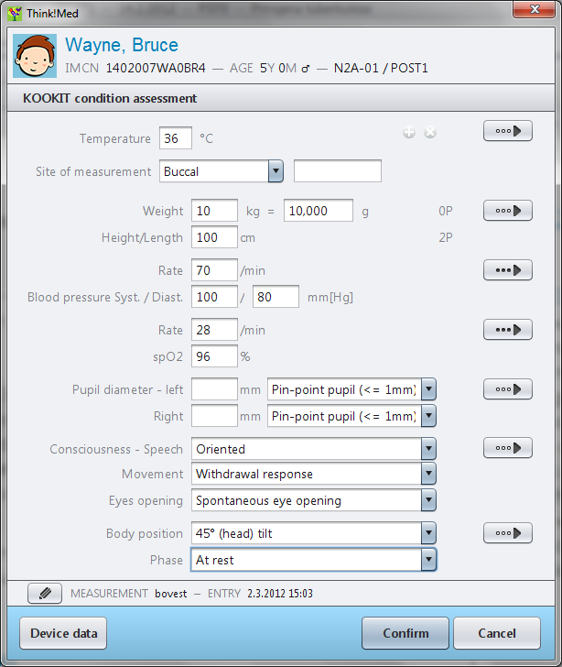
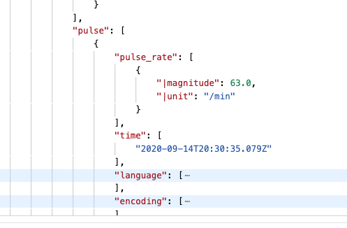
Introduction to archetypes and templates
I want to record ‘pulse rate’

Slide 2
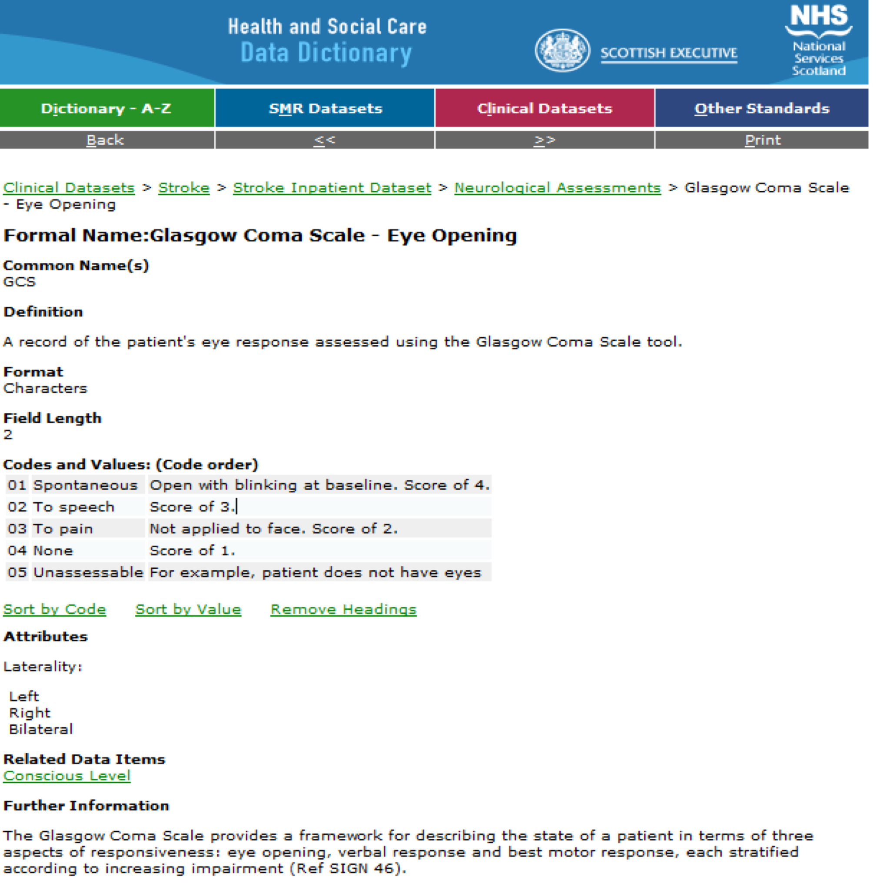
Traditional modelling: the data dictionary

Slide 3
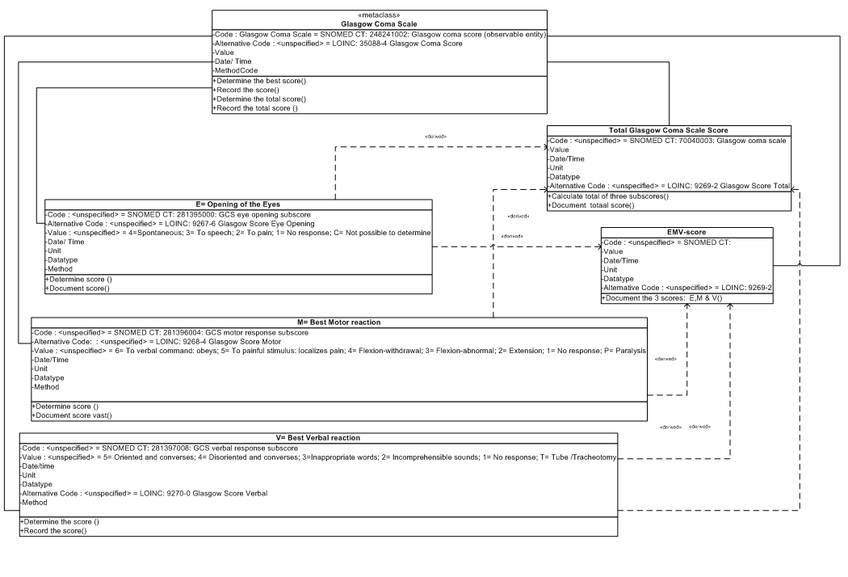
UML: Clinically unfriendly

Slide 4
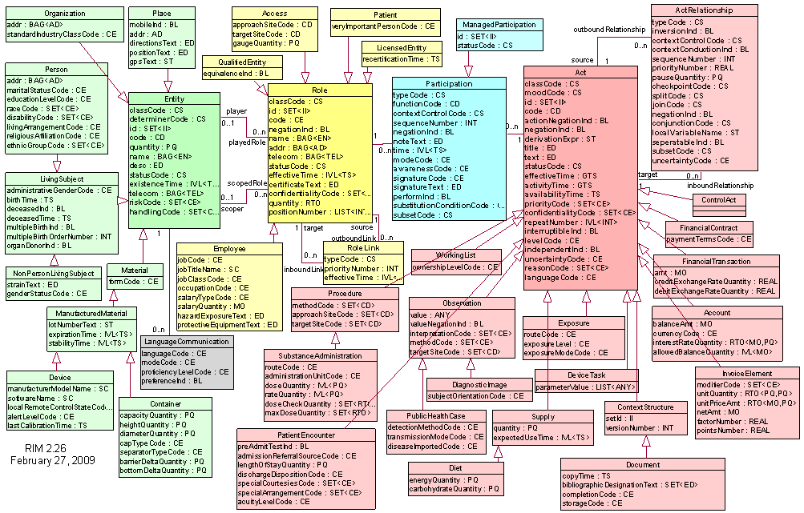
Traditional modelling: “technical complexity”?

Slide 5
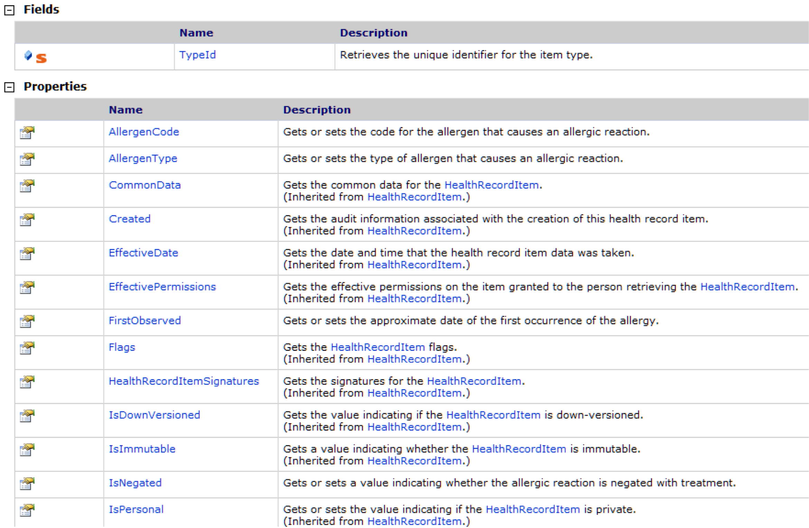
Clinically-accessible?

Slide 6

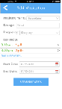
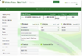
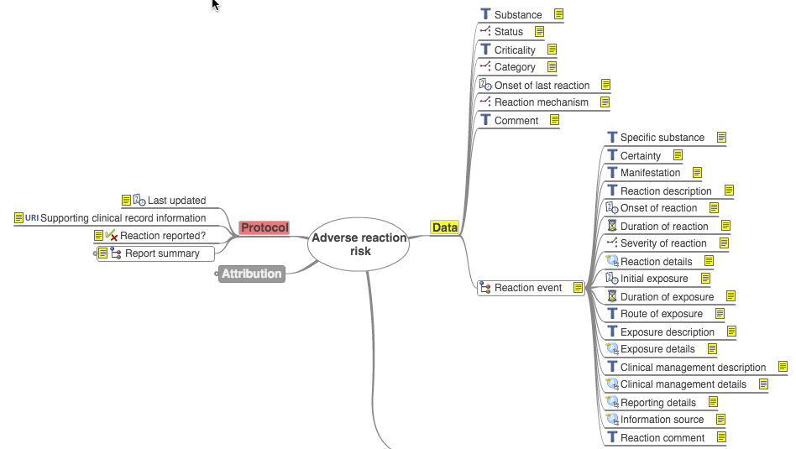
openEHR: clinicians in control
Third-party apps
Vendor-neutral Information model
Technology-neutral datastore (CDR)

Slide 7
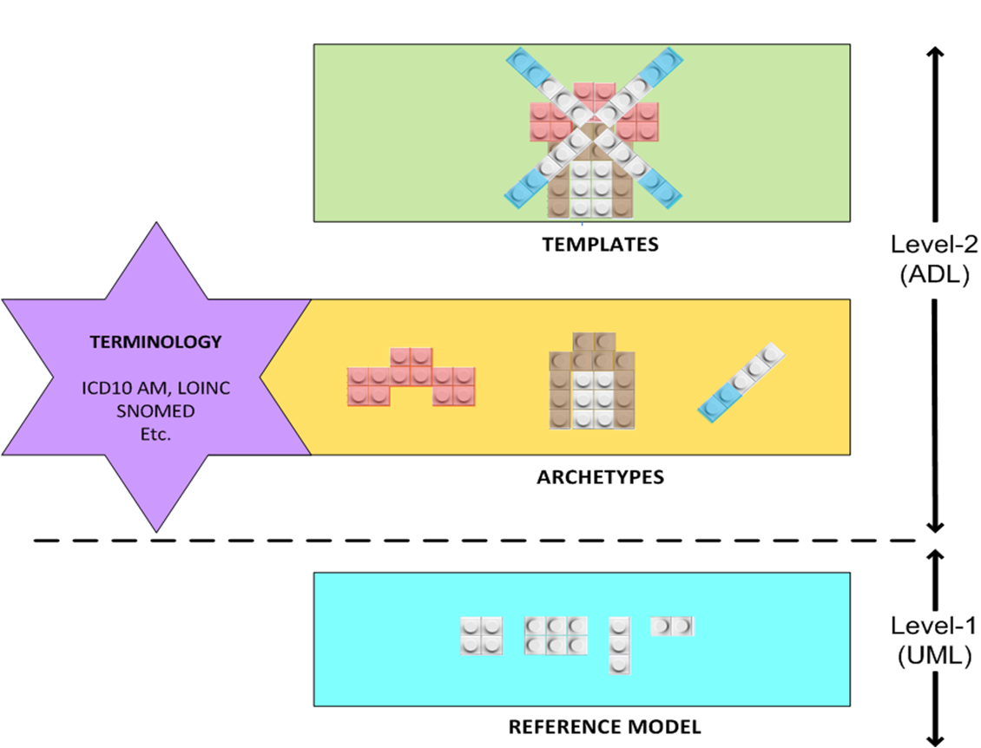
openEHR: Multi-level modelling

Slide 8
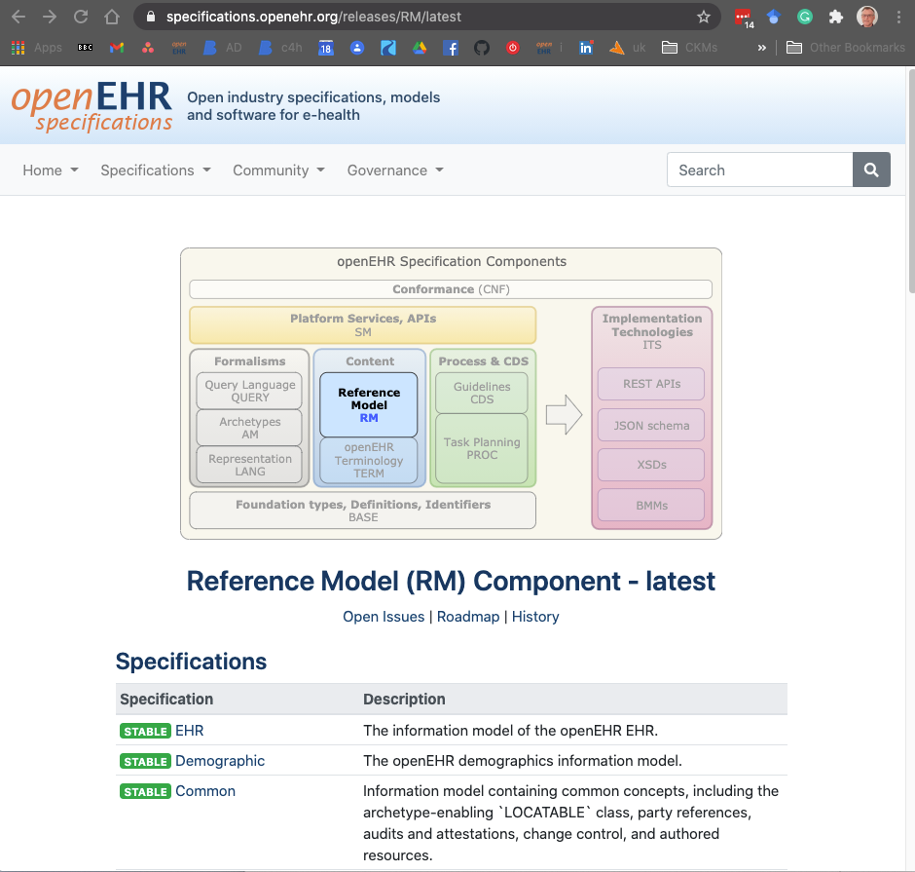
openEHR Reference Model (RM)
Generic technical artefacts for representing health information
Data structures and types
Overall health record structure
Security, Versioning
People, Dates, Times etc.
Deliberately hidden in the clinical modelling tools
https://specifications.openehr.org/
https://specifications.openehr.org/releases/UML/latest/index.html

Slide 9
openEHR Health Record
EHR
Electronic health record for one person
Folders
High level organisation of the EHR,
e.g. by episode or by specialty
Compositions
Set of entries comprising a clinical care session or document, e.g. encounter, result
Sections
Clinical headings reflecting workflow or consultation process
Entries
Clinical statements about observations, evaluations, instructions, actions
Clusters
Entry subcomponents, e.g. device details or inspired oxygen information
Elements
Leaf nodes of name-value pair and datatype, e.g. body weight = 60kg (Quantity)

Slide 10
Reference model for newbies
Mostly technical infrastructure
Does carry some common clinical infrastructure
The author of the document
The person saving the document
The time and status of an action
The time of an observation
Reference ranges
These do not need to be modelled in archetypes as they are already inherited from the parent class.

Slide 11
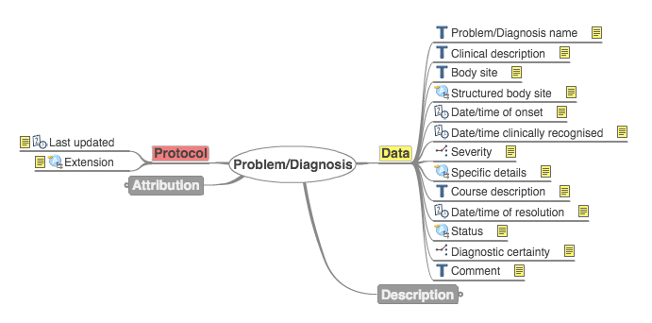
openEHR Archetypes I
Computable models of discrete clinical concepts
Familiar components of a health record
Blood pressure, Body weight, Symptom
Medication order, Family history
‘Maximal dataset’ philosophy
Capture as many clinical perspectives as possible
Problem/Diagnosis, Published Archetype [Internet]. openEHR Foundation, openEHR Clinical Knowledge Manager [cited: 2016-03-09]. Available from: http://openehr.org/ckm/#showArchetype_1013.1.169

Slide 12

openEHR Archetypes II
can be designed for specific local use case
particular data entry screen
local message
most useful when designed to be shared and reused
“What do WE mean by pulse rate”
Potential for a SINGLE, SHARED MODEL of clinical content

Slide 13
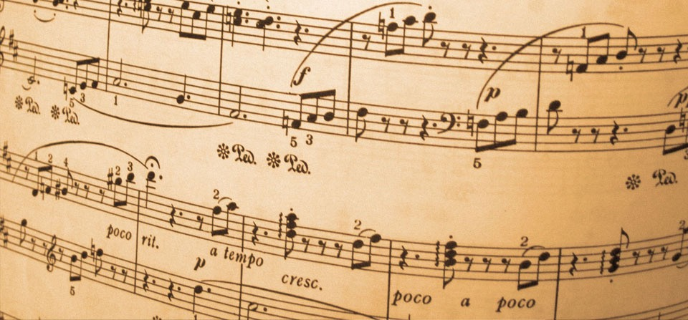
COMPOSITION archetypes
‘Top level document’ container for all clinical data
All clinical data saved inside a Composition
Represent generic document types in clinical system
Encounter, Report, Lab Report
Problem List, Discharge Summary, End of Life Care plan
Simple
Do not define detailed content.

Slide 14
‘Persistent’ compositions

Slide 15
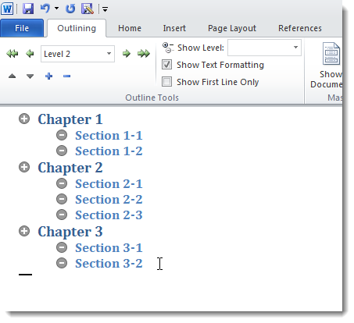
SECTION archetypes
Sub-divide complex compositions
No ‘semantic’ meaning
Meaning carried in ENTRY archetypes names inside SECTIONS
Very few pre-defined SECTION archetypes

Slide 16
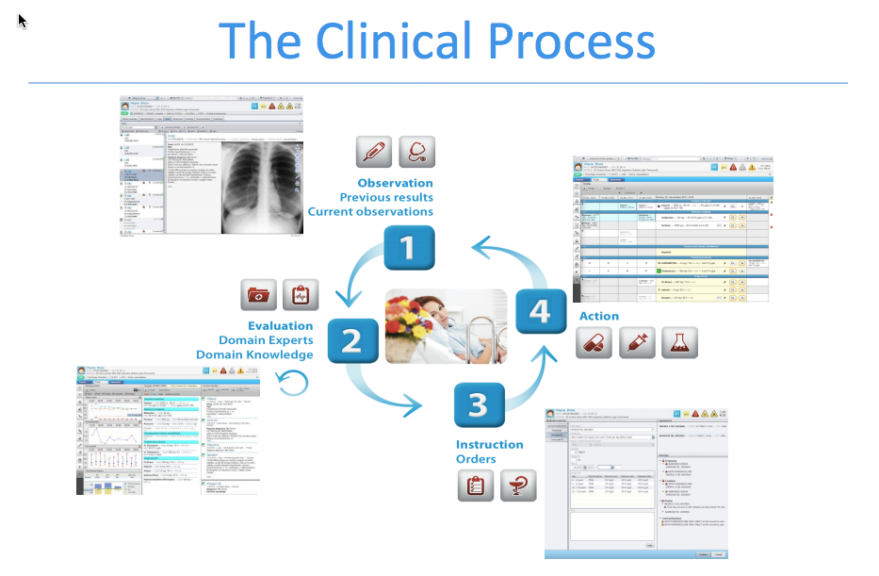
The ENTRY archetypes

Slide 17

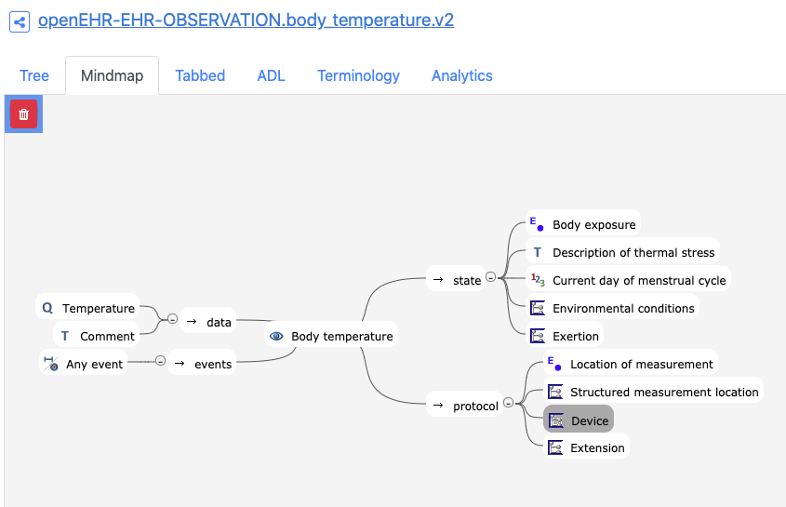
OBSERVATION archetypes
Gathering of evidence
Measurable / observable data
Patient history, physical examination
Lab tests, imaging
Scores and scales

Slide 18

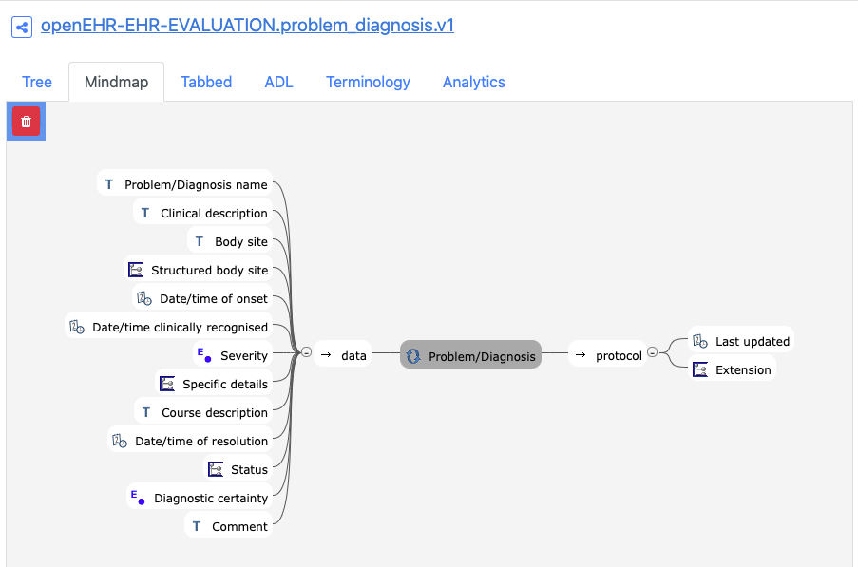
EVALUATION archetypes
Outcomes of a clinical assessment or decision
Clinically interpreted findings
“I think the problem is …”
I think there is a risk of …
The treatment goal is …’
Diagnosis, synthesis
Genetic risk, Risk of Adverse reaction
CPR Decision

Slide 19

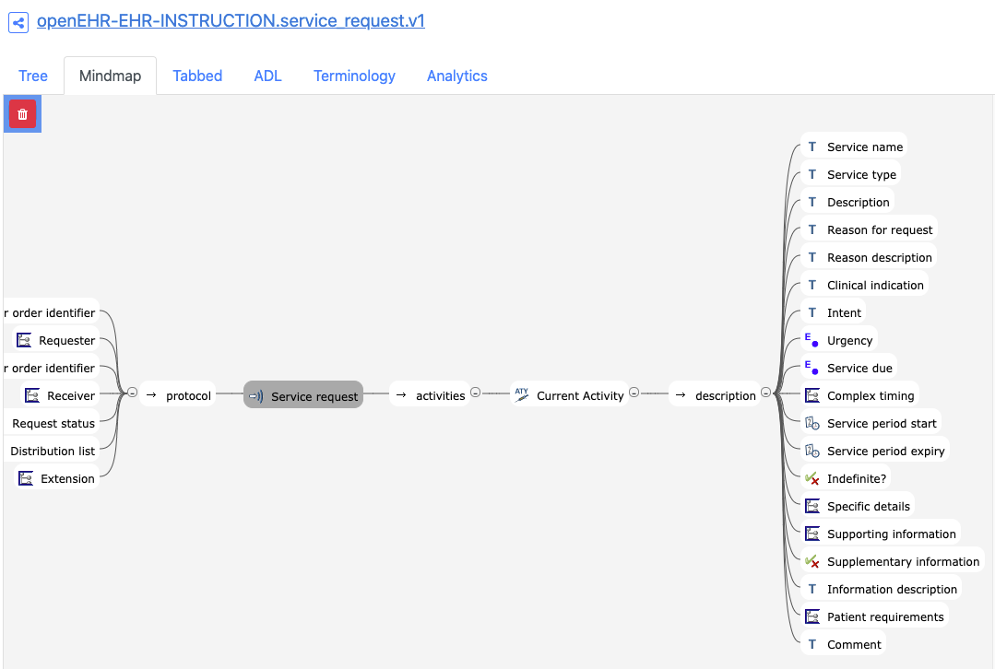
INSTRUCTION archetypes
Orders that arise from clinical assessment
Initiation of workflow process
“I will order some blood tests”
“I would like you to start this medication”
“I would like to refer you to a specialist”
Lab test request, referral
Medication order
Nursing task

Slide 20

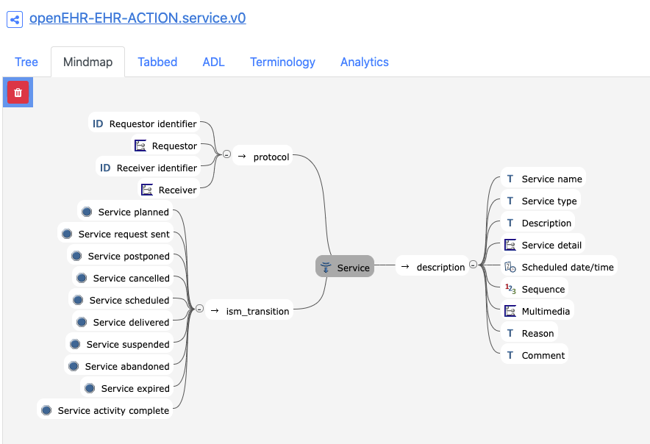
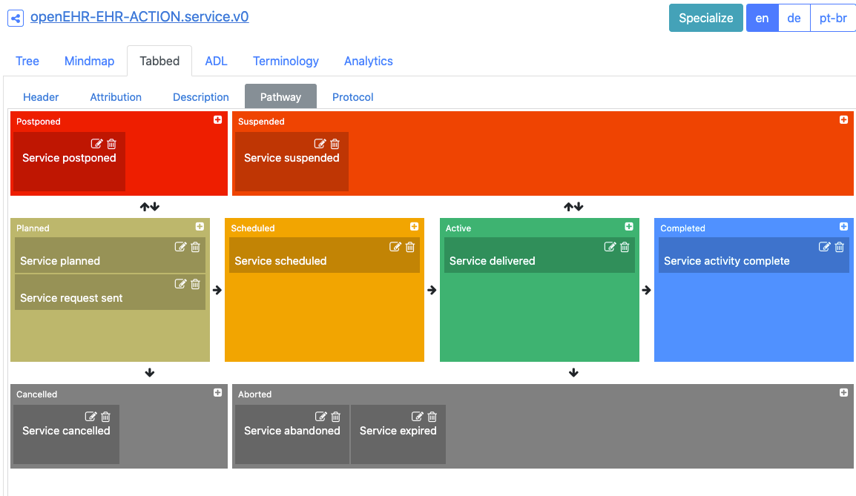
ACTION archetypes
Activities that result from an Instruction
“Lab test performed”
“Medication prescribed, administered”
“Procedure performed"
“Lab test tracking”
“Medication supply”

Slide 21
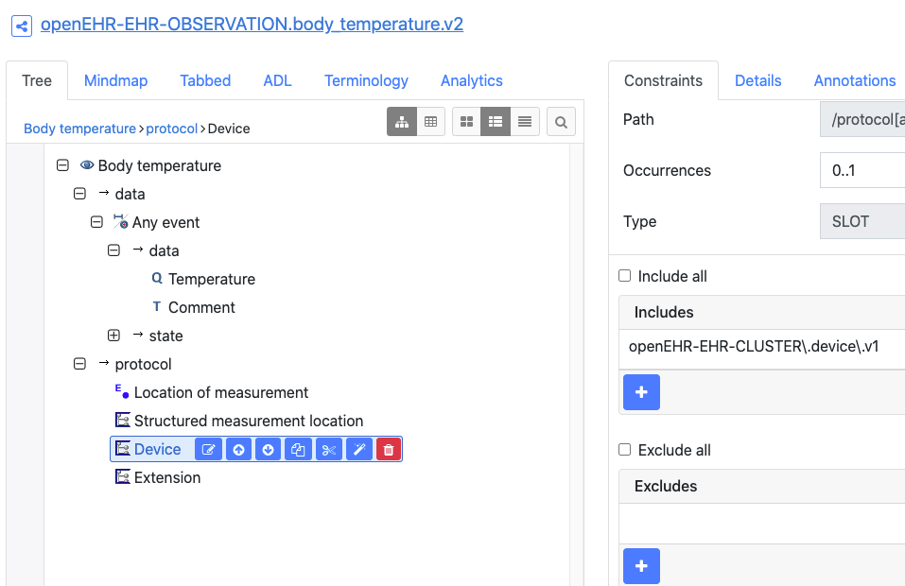
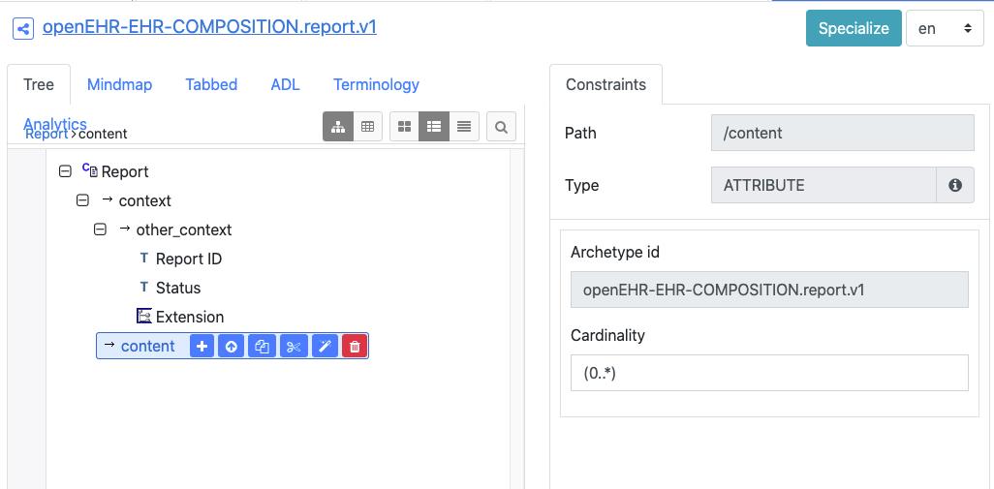
Slots
Where one archetype can be slotted into another
Entry, Section into Composition
Entry into Composition
Cluster into Entry
But not Entry into Entry

Slide 22
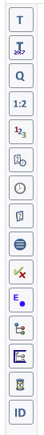
openEHR RM datatypes
The modelling tools expose most aspects of the data types that are of interest to the clinical modeller
Some RM attributes of datatypes are not clear or only apply to the actual data, not the models
Coded Text
Quantity
Proportion
Count
Datetime
Time
Date
https://specifications.openehr.org/releases/RM/latest/data_types.html
Ordinal
Boolean
Choice
Cluster (internal)
Slot
Duration
Identifier

Slide 23
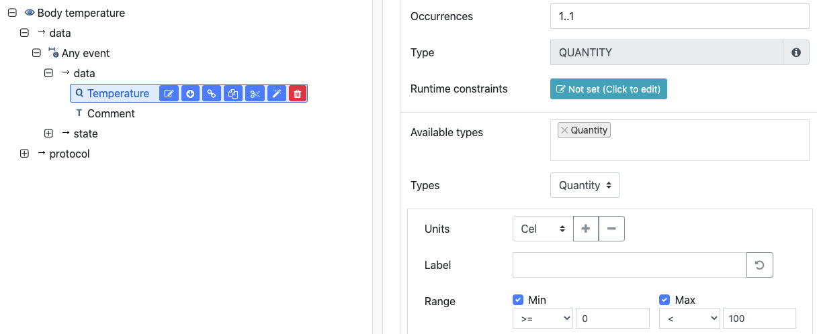
Quantity datatype
Units
e.g.mmHg, mmol/l, /min
Normal_range
For lab or device normal ranges
e.g. 20-46 mmol/l
Other reference ranges
For age or sex-specific reference ranges
Normal range for children : 18-28 mmol/l
Magnitude_status
To allow numeric to be qualified
E.g <= 5 (Less than or equal to 5)
∼ 7.3 (approximately 7.3)
Normal_status
High, normal, low based on HL7 lab messages
e.g. HHH,HH,H, ,L,LL,LLL

Slide 24
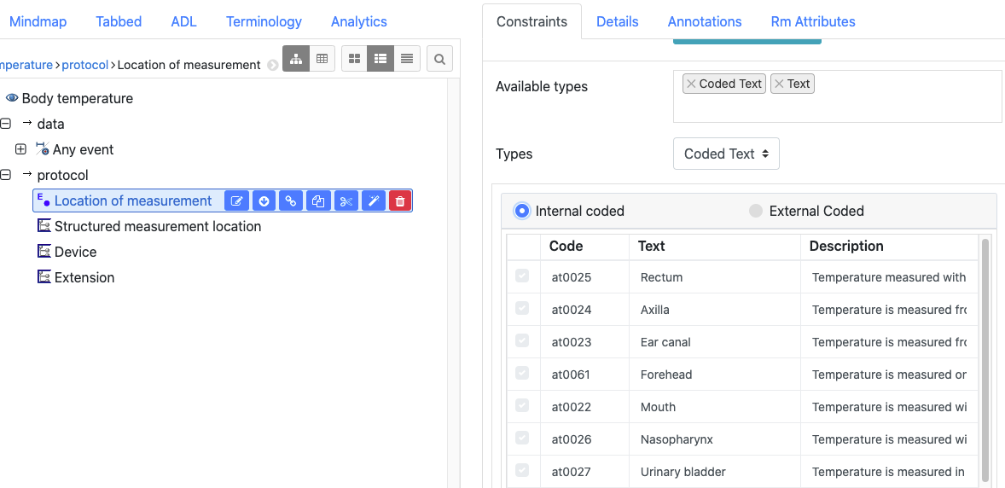
Text/CodedText datatype
Any Text datatype can also act as a CodedText datatype
if you have defined an element to be Text, it can still carry CodedText
Defining_code
The actual code of a CodedText e.g “123478-AS”
The terminology/version of the CodedText e.g. “ICD-10”
Mappings
to external terminologies
e.g. The original code is an internal code “at007::Left” but is mapped to SNOMED code |123456|left|

Slide 25
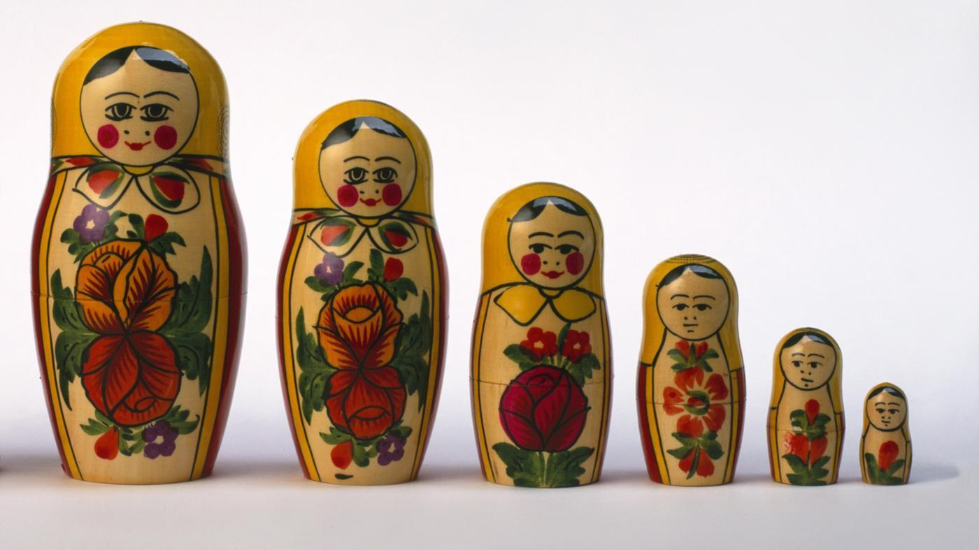
Other datatypes
Duration : 1 day , 3 minute, including ages
Boolean: True/ False
Proportion: 83%
Ordinal: 3: Moderate
Multimedia: Image, Sound
Identifier: NHSNumber
Parsable Text: XML, JSON
URI : Web-type links

Slide 26
‘Event’ category
Each time new data is committed, a completely new composition instance is created
Lab reports, nursing observations, doctor encounter
5c8a8636-bc98-4441-abd5-e9cf396e8833::ripple_osi.ehrscape.c4h::1
77a-bc98b345-4421-ba6d5-fc89f396e8855::ripple_osi.ehrscape.c4h::1
Ehrscape POST /composition

Slide 27
‘Persistent’ Category
Each time new data is committed, the original instance is overwritten
Problem list, End of Life Summary
77a-bc98b345-4421-ba6d5-fc89f396e8855::ripple_osi.ehrscape.c4h::1
77a-bc98b345-4421-ba6d5-fc89f396e8855::ripple_osi.ehrscape.c4h::2
Ehrscape PUT /composition

Slide 28
Episode vs Longitudinal persistence
Longitudinal Persistence
Some persistent summaries should exist and be updated throughout the patient’s lifetime
End of Life summary, GP problem list
Episodic Persistence
Most outpatient and hospital summaries e.g Allergy lists, Problem lists need to be re-created at admission, then maintained for the period of admission.
A new Problem list may need ot be created for each episode of care

Slide 29
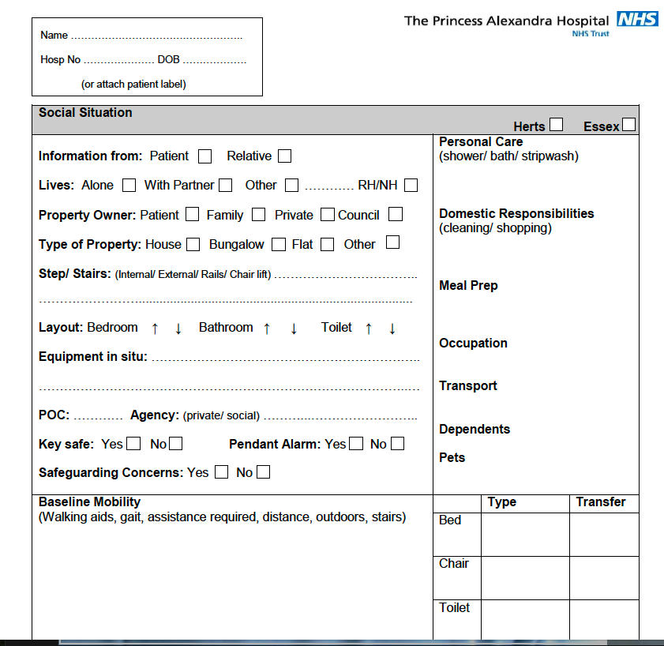
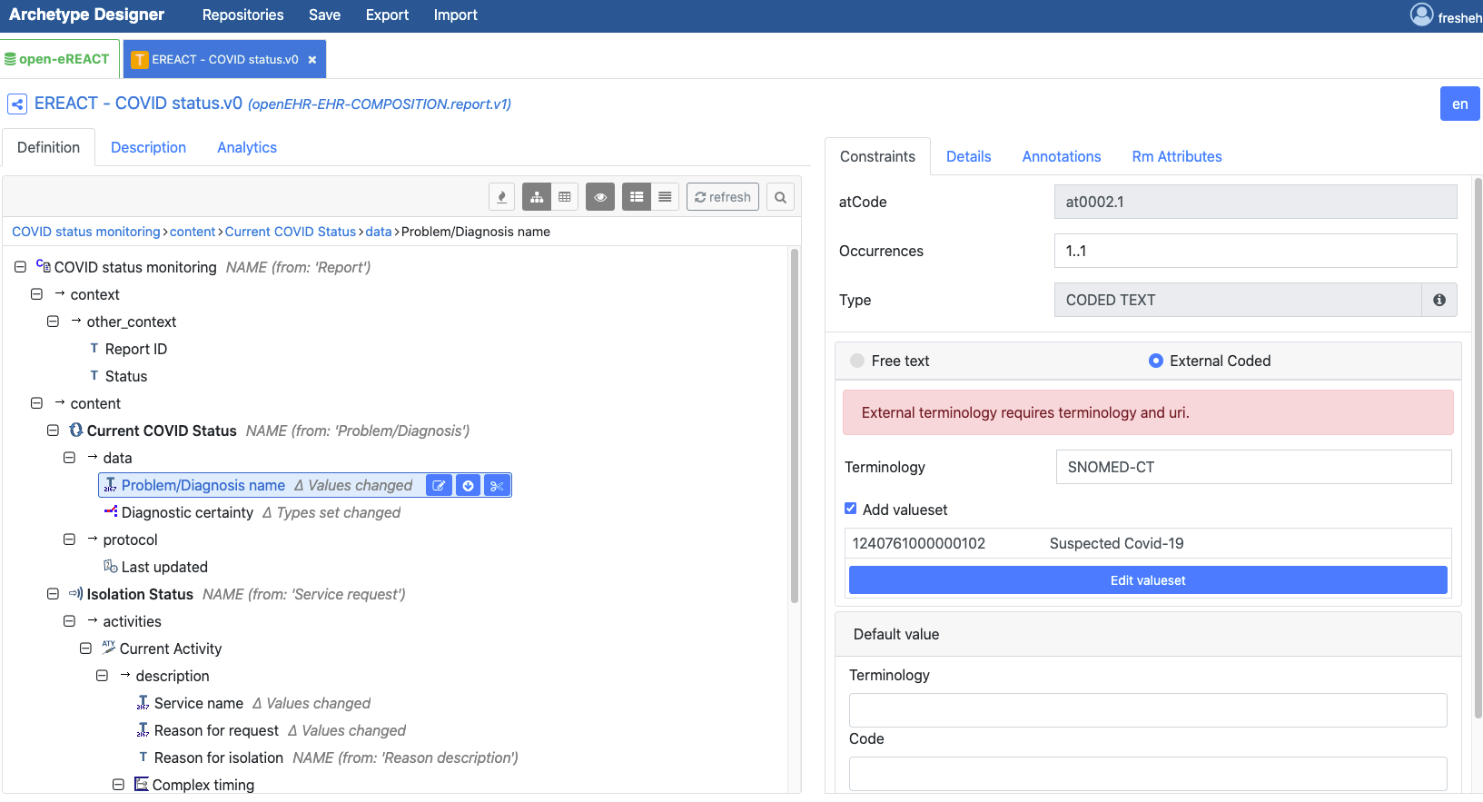
openEHR Templates
Computable models bringing together component archetypes
create a dataset for a particular clinical context or purpose
adjust component archetypes to make them 'fit for purpose’
make items mandatory
remove unwanted items
set default values
create terminology mappings
In practice, creating a dataset to underpin
data entry / message / interface definitions

Slide 30
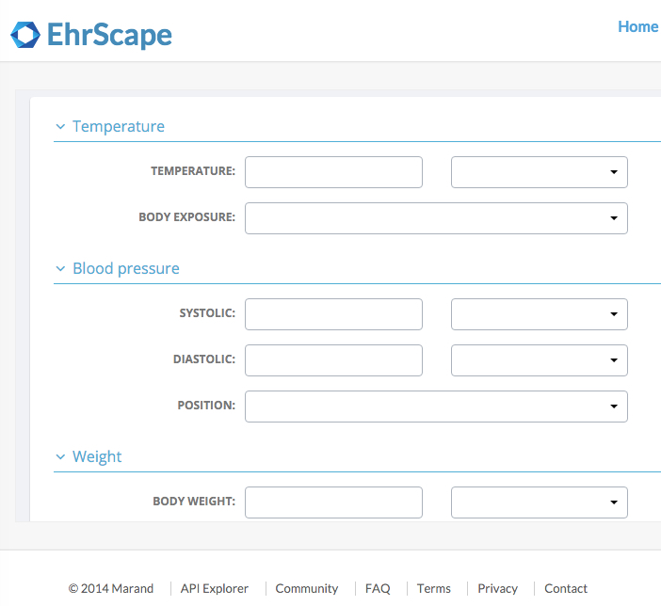
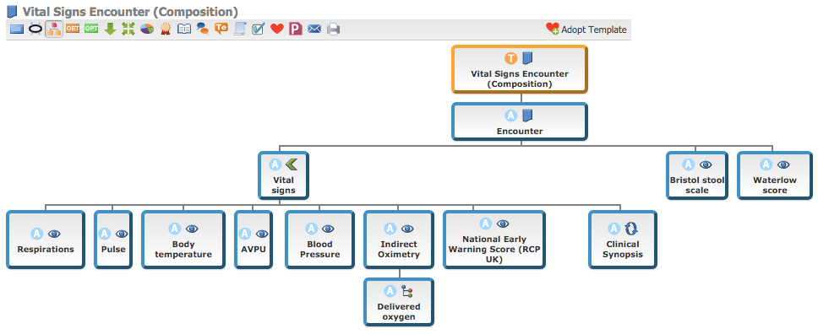
Templates vs Forms
Form = User Interface
Template = Dataset
Vital Signs Encounter (Composition), Draft Template [Internet]. UK Clinical Models, UK Clinical Models Clinical Knowledge Manager [cited: 2016-03-09]. Available from: http://clinicalmodels.org.uk/ckm/#showTemplate_1051.57.23
https://www.ehrscape.com/forms-demo.html

Slide 31
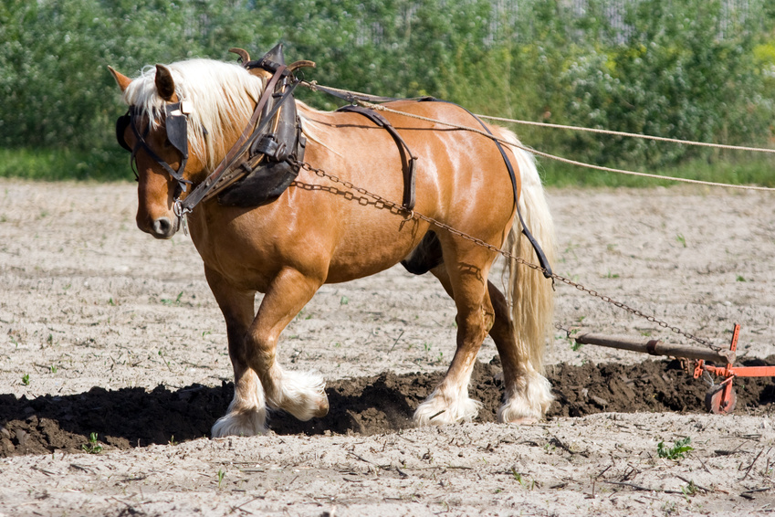
Templates - the openEHR ‘workhorse’?
Archetypes get the glory, templates deliver the datasets
Key clinical endpoint and starting point for generation of technical artefacts
Class libraries, GUI skeletons, Message schema
Most demand for archetyped content will originate as requests for datasets
Data entry forms
Diabetes shared care message
Discharge summary message

Slide 32
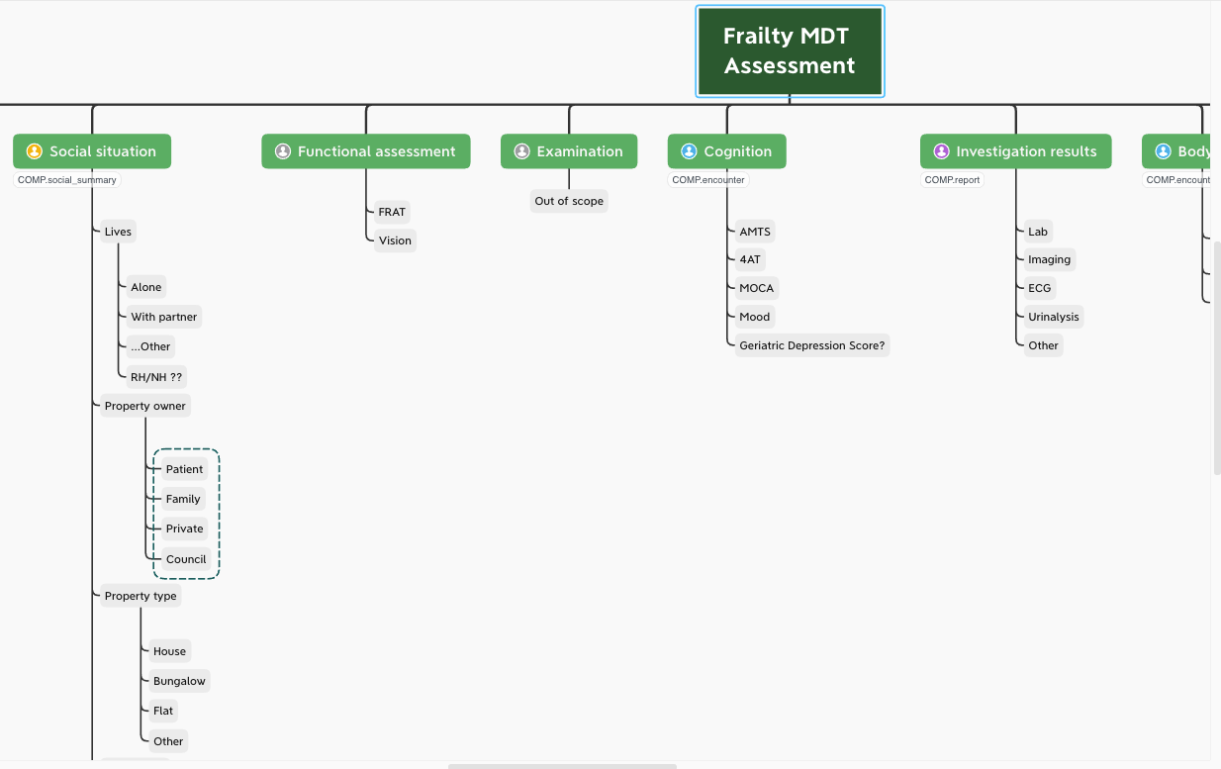
XMIND Mindmaps

Slide 33
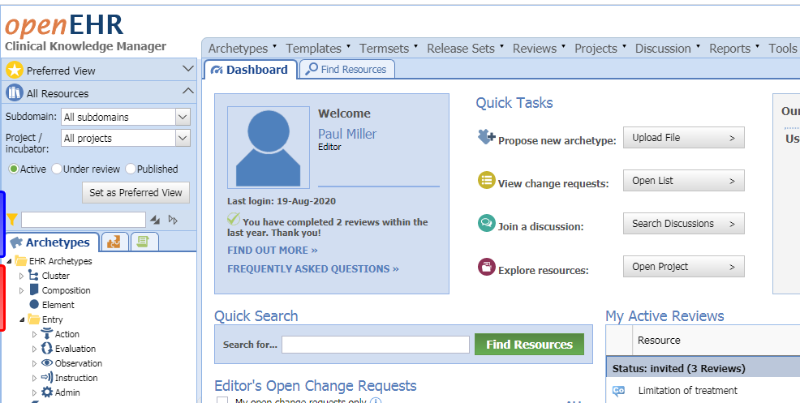
CKM: Clinical Knowledge Manager
Repository
Collaboration for Reviews
Two main CKMS
International:
https://ckm.openehr.org/ckm/
UK & 5 Nations / Apperta
https://ckm.apperta.org/ckm/
Searching
Sharing
Reviewing

Slide 34
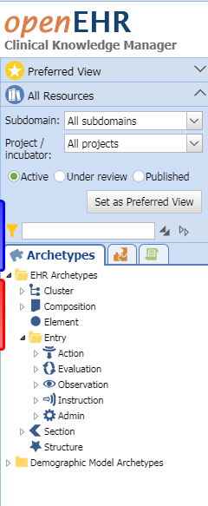
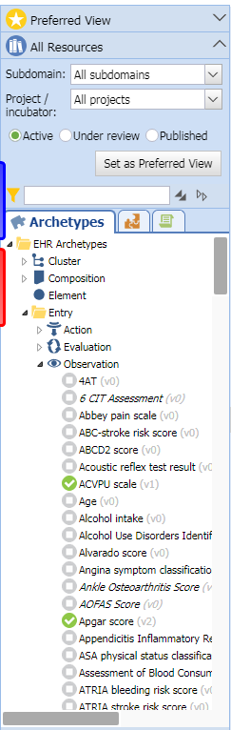
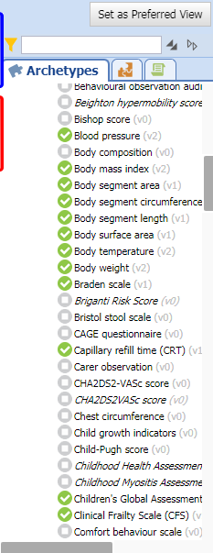

Slide 35
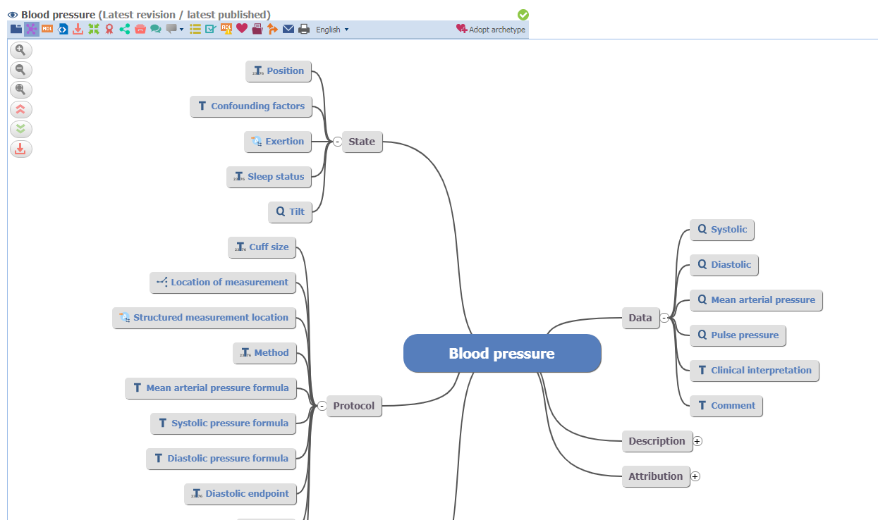

Slide 36
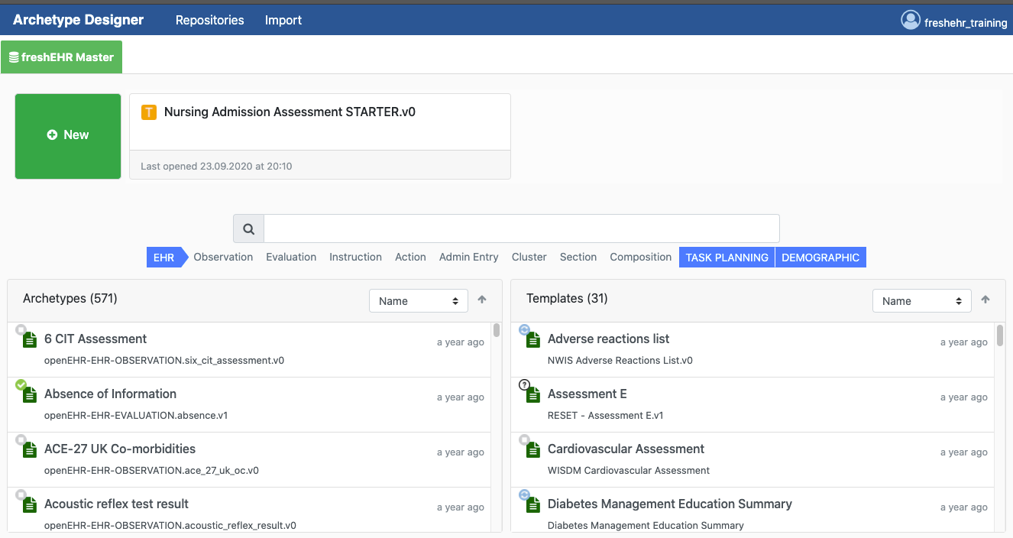
AD:Archetype Designer
https://tools.openehr.org/designer

Slide 37
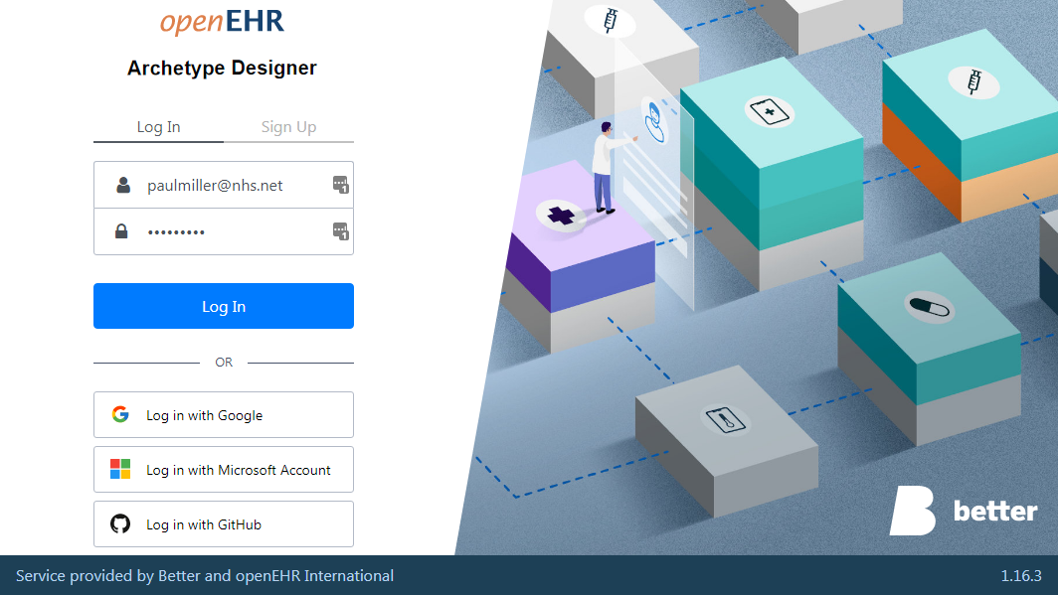
Archetype Designer
https://tools.openehr.org/designer/#/
For creating Archetypes and Templates
Can store locally / cloud
Github
Download from CKM, import to AD
Export from AD, upload to CKM
Marand (Better) tool – free to use

Slide 38
Templates

Slide 39
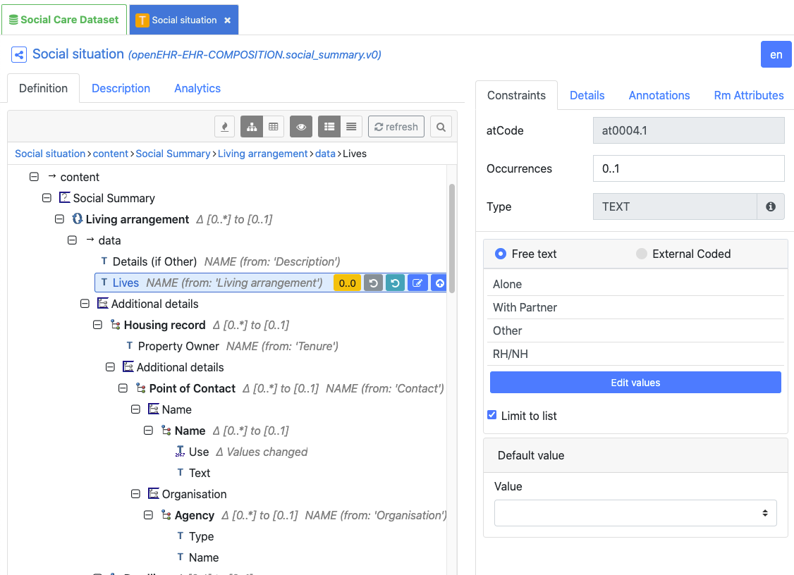
Use-case dataset

Slide 40
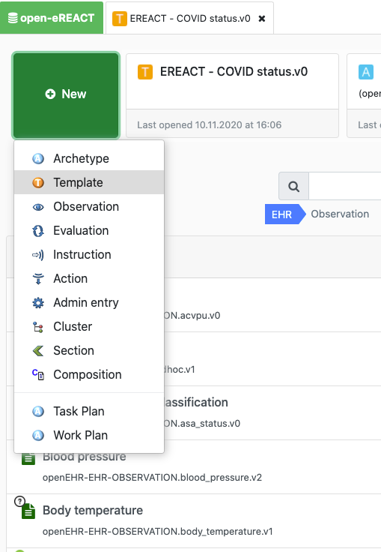
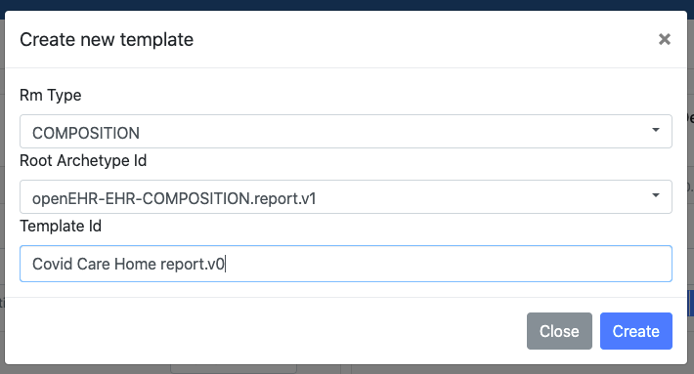
Create a new template

Slide 41
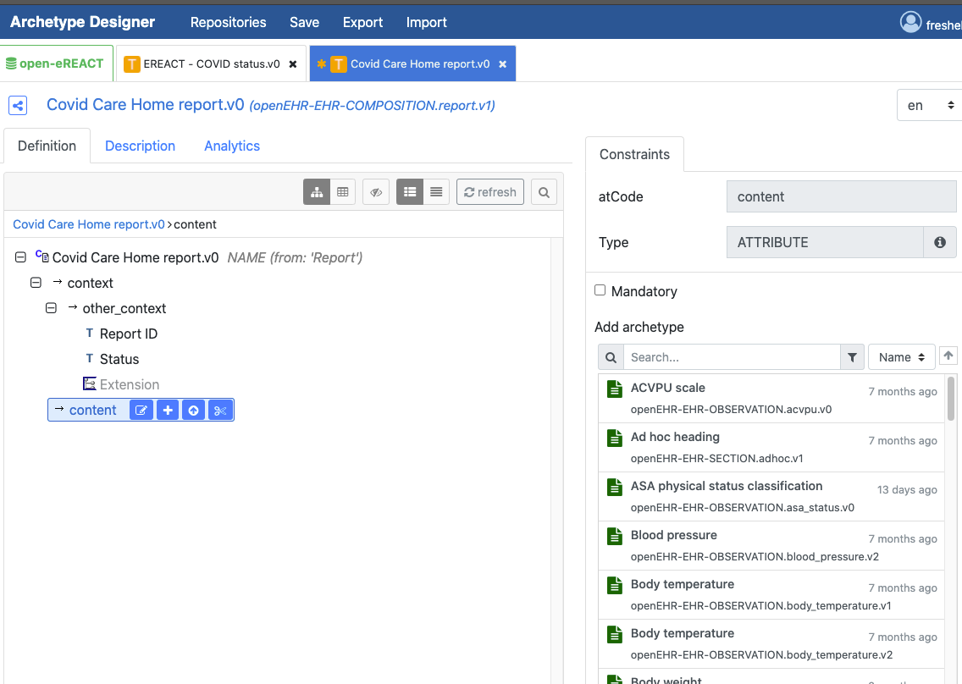
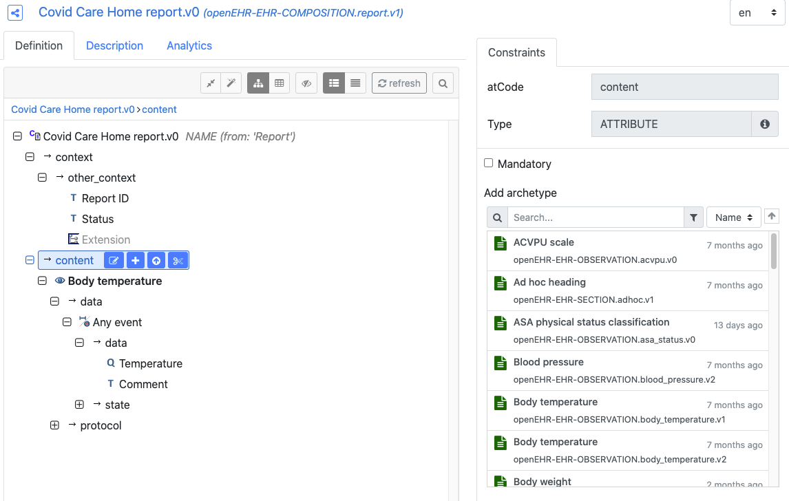
Add an archetype

Slide 42
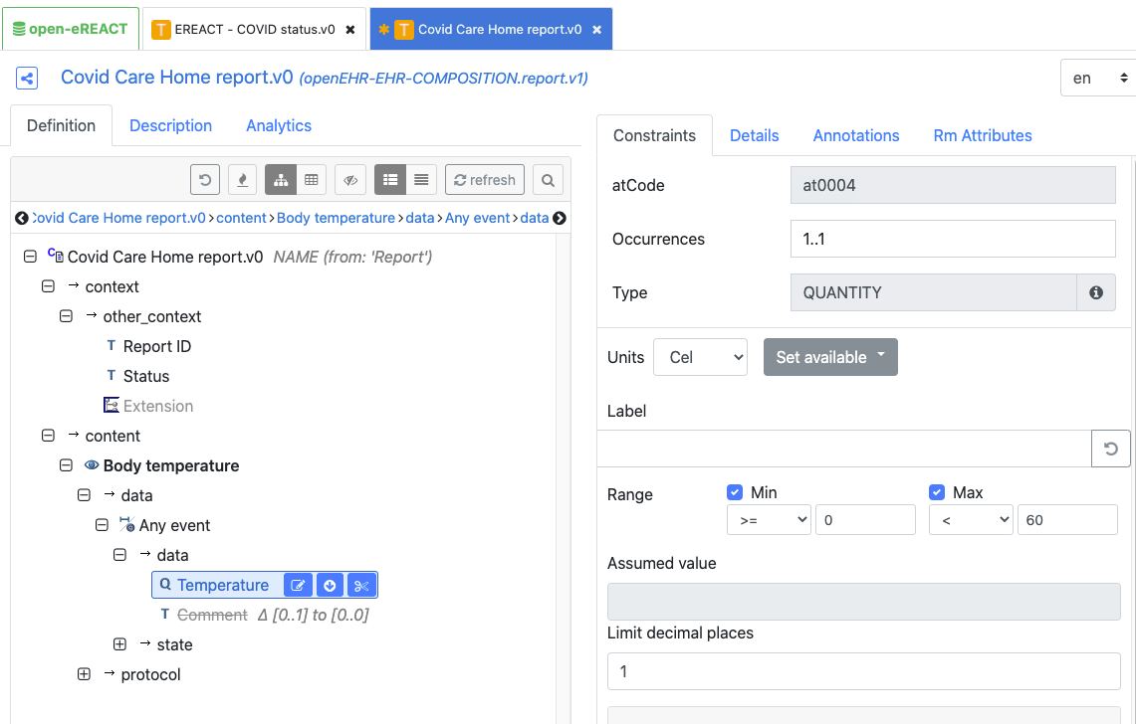
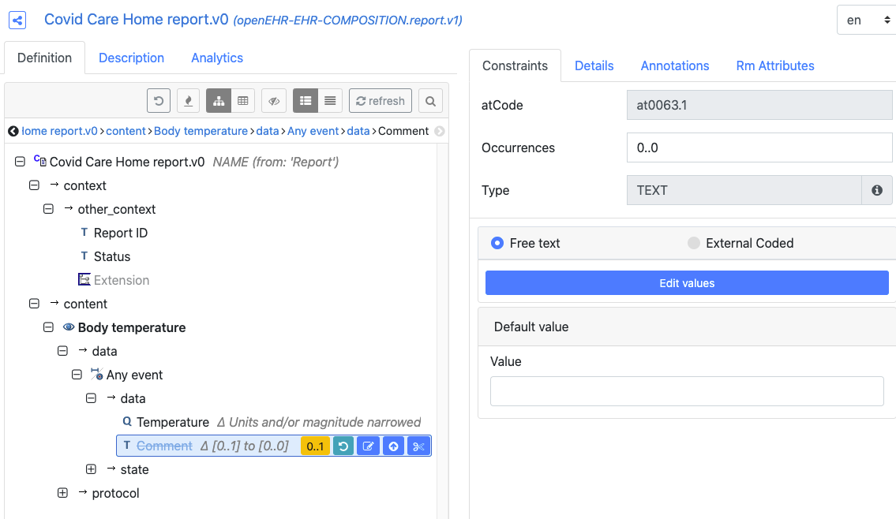
‘Constrain’ the template

Slide 43
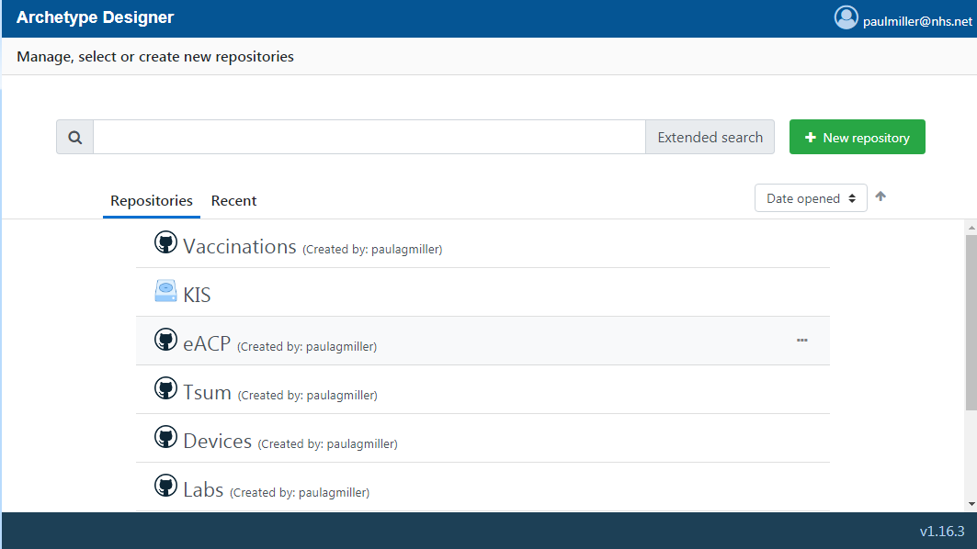

Slide 44
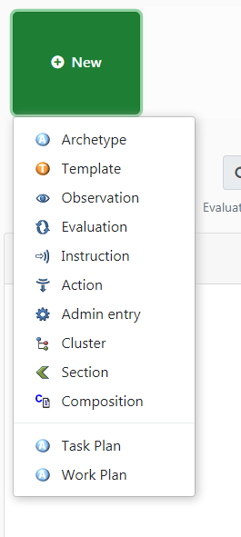
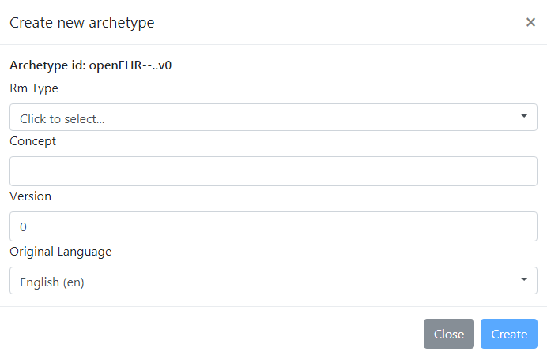

Slide 45
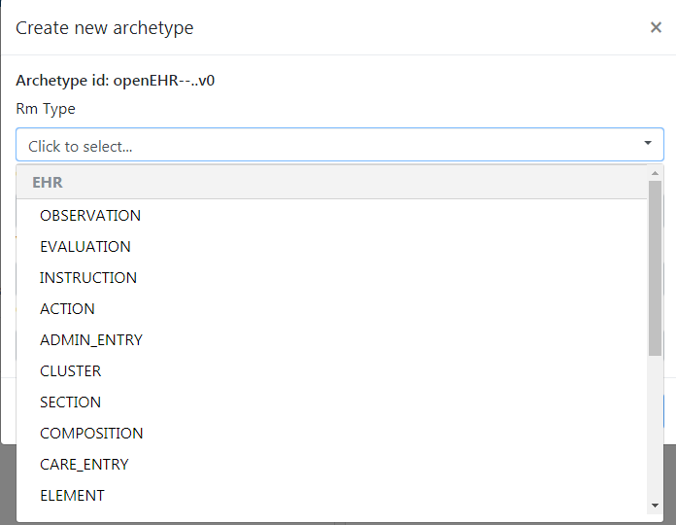

Slide 46



Slide 47



Slide 48



Slide 49


Better Studio
CDR utility
Form-builder
AQL Builder

Slide 50

Practical session
https://freshehr.github.io/training/

Slide 51
Where does terminology fit?
Each archetype carries its own unique, internal terminology, to support multiple languages
“Diastolic” [at0005]
Archetypes and templates work alongside external terminologies, not in conflict
We can specify ‘bindings’ to multiple external terminologies
e.g. ICD, SNOMED CT, LOINC

